Slide 1


Compassionate Companions
A specialized volunteer program at
USC Verdugo Hills Hospital
Tina Marie Ito

Slide 2
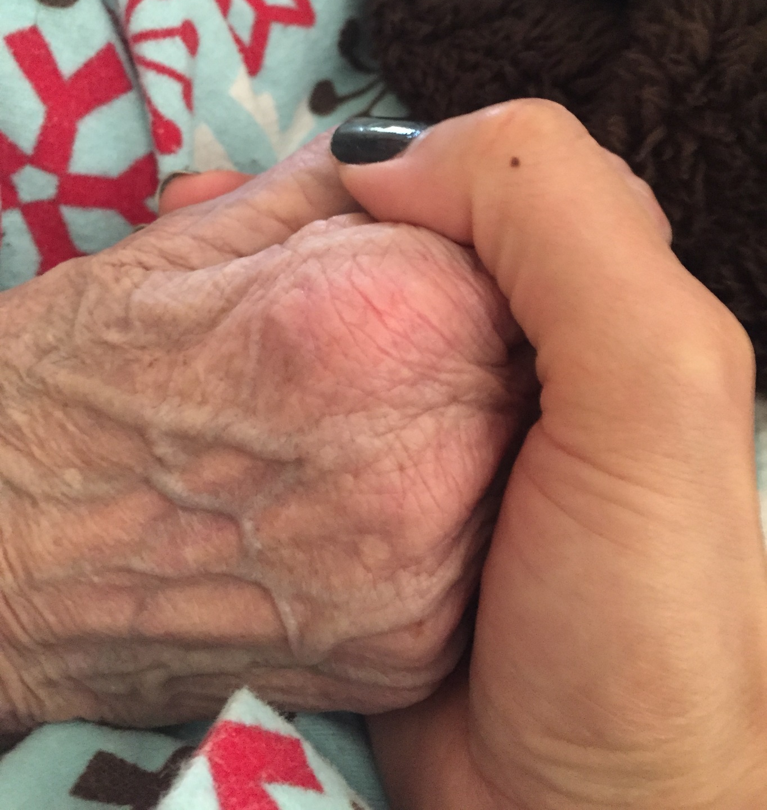
Moments that matter
Notes:
Tell your story about why this was important to you

Slide 3
The beginning
“Will you stay with me?”
“I felt like I had let him down. Here you are in a high-tech world in medicine and he only asked for something very simple. It seemed so wrong to me. I felt guilty and frustrated. It wasn’t that anyone had done anything wrong. But it wasn’t done right.”
Sandra Clarke, RN - Sacred Heart Medical Center.

Slide 4
Compassionate Companions
The origin and evolution
1986
The origin
Eugene, OR
No One Dies Alone
Sandra Clarke, RN
2018
Creation at USC Verdugo Hills Hospital
Strong champion to spearhead effort
Partnership with Risk Management (at the time responsible for Patient Family Advisory Council) and Patient Experience
The Covid Years
Identifying ways to adapt
Recruited and trained staff
2023
Expansion beyond end of life.
Service for individuals needing bedside companionship or families needing respite
Notes:
It was a rainy night in Eugene, Oregon when Sandra Clarke, RN, was working as a staff nurse at Sacred Heart Medical Center. While making rounds at the beginning of her shift, she entered the room of a frail, elderly man. In a barely audible voice, he pleaded, “Will you stay with me?” Sandra promised him she would return as soon as she checked on her other six patients. After taking longer than she had anticipated, she returned to his room, ready to apologize for the delay. As she approached his bedside, she saw his pale, outstretched hand. He had died alone. She vowed to change this process by finding a way in which other patients at her hospital would never have to die alone.
Thus began the No One Dies Alone (NODA) program, comprised of employees within the hospital, and volunteers from outside, who stepped in to be present in the patients’ time of need.
2018 beginning – 7 (Tina, Cindy, Angela, Bridget, Teri, Ruth, Andrea)
Covid – 9 staff people
2023 - 14

Slide 5
Our Mission
To provide compassionate service to our patients by having
bedside companionship for individuals who may need partnership,
and for dying patients who are alone at the end of life.

Slide 6
Program Summary
Compassionate Companions is a Volunteer Program that offers a reassuring presence of a volunteer companion to help provide support to VHH patients who do not have family or close friends who can visit or sit during illness or at the end of life. The program philosophy is that no one should be alone in their time of need.

Slide 7
Volunteer Requirements
Must be at least 25 years old
Have not experienced a close personal loss within the last 6 months
Ability to:
  Create and support a safe, calming and peaceful environment
  Provide affirming energy
  Carry out role in a non-denominational manner (unless upon patient request)
Adhere to hospital policies (including HIPAA patient confidentiality and privacy laws)
Complete and adhere to:
  USC Verdugo Hills Hospital Volunteer Orientation
  NODA Volunteer Training
  Employee Health requirements and Background Check
  Flu vaccine and Covid-19 vaccination requirements

Slide 8
Activation of Compassionate Companions
Patients are typically identified by the nurse or Charge Nurse, Patient and Family Services, Patient Experience or Nursing Supervisor
Activation involves contacting the program coordinator (2 individuals can initiate)
Text / email is sent to the approved volunteers
Schedule put together and re-distributed via text
Volunteers provide service when they are available
Group debriefs as needed

Slide 9
Arrival of Volunteers
Check in with the Charge Nurse and the patient’s nurse
Confirm patient is still in need of support and confirm room number and name
Identify any safety precaution measures that are needed.
Ask the nurse if there are any notes in the chart or that they are aware of, that provides details about what the patient’s preferences and likes
Hand off any pertinent information to other volunteer and primary nurse

Slide 10
Training
Greeting your patient
What to expect at end of life
Signs of Approaching death
When to notify the nurse
What a volunteer can / can’t do
Ideas for engagement
Donning and doffing PPE

Slide 11
Debriefs
Debriefs will be scheduled as needed. If there are cases throughout the month, these will be monthly.
Encouraged, but not required to participate.
Provides time to reflect and share
Notes:
What’s significant emotion or lingering? Listen to the emotion. Validate, Ritual – washing hands (Symeon)

Slide 12
Questions?
Contact Info:
Tina Marie Ito, Chair, USC Verdugo Hills Hospital Foundation Board
tinamarieito56@gmail.com
818-585-4242
Bridget Berg, Patient Experience
Bridget.berg@med.usc.edu
USC Verdugo Hills Hospital

Slide 13
Next slides for reference only

Slide 15


Slide 16
Meeting your patient
Introduce yourself, your name, role, and purpose.
Good morning, my name is xxxx, I am a volunteer and I am here to be with you. I’ll stay with you for a while.
If the patient is alert, you can engage with open-ended questions about their life. Create the space for them to share.

Slide 17
What to expect at end of life
Patient stops eating, drinking, and speaking
Grimace, groan or scowl from pain
Eyes tear or glaze over
Muscle relaxation around mouth and eyes may not close
Pulse and heartbeat are irregular or hard to feel or hear
Body temperature drops or possible fever
Breathing is interrupted by gasping and slows until it stops entirely
If they are not unconscious, they may drift in and out, but they can probably still hear and feel
Skin on their knees, feet, and hands turns a mottled bluish-purple (often in the last 24 hours) – this can be a quick change
(Content from: https://www.webmd.com/palliative-care/journeys-end-active-dying#2)

Slide 18
Signs of Approaching Death
Decreased appetite
Increase in sleep
Irregular and/or weakening of pulse and heartbeat
Decreased body temperature, particularly extremities
Decreased bowel and bladder movement
Changes in level of consciousness
Decreased and often intermittent breathing

Slide 19
When to notify the nurse if:
Patient is pulling at tubes
You are concerned for any reason

Slide 20
Patient Support (Slide 1 of 2)
What you can do
Volunteers can
Adjust or ask for room temperature adjustments
Move bedside table closer/Move needed items within easy reach
Assist with making phone calls/phone
Change TV channels or turn the TV on/off
Turn lights on/off; close door/open door
Requests for towels, wash cloths, blankets, gowns, etc.
Open and/or close privacy curtains
Obtain any other non-medical miscellaneous items such as pens, pencils, books, magazines etc.
Other engagement activities

Slide 21
Patient Support (Slide 2 of 2)
What you cannot do
Volunteers can not
Give patient snack/water (without RN approval)
Physically assist a patient
Adjust the bed -head up/down (fall risk/check restrictions)
Offer pain relief/provide medication
Explain clinical matters
Explain tests and treatments or patient scheduling
Adjustments / interactions with an IV
Assist patient with eating or drinking
Repositioning request/Raise or lower a patient bed
Toileting assistance/Assist patient in or out of bed (fall risk)
Serve as an interpreter
Initiate religious practices without knowing the patient’s preference

Slide 22
If the patient is engaged and would like a visit, here are a few ideas to spend time
(can ask the patient, if possible)
Listening to music
Guided imagery (spoken)
Reading (newspaper, poetry, spiritual book)
Cup of tea or coffee (get permission from nurse first)
Watching their favorite television show
Other Ideas?
When the visit is over, thank the patient for allowing you to visit. Ask them if they would like a return visit, and when.
If the patient is not alert or oriented, assume they want a visit.

